Slide 1
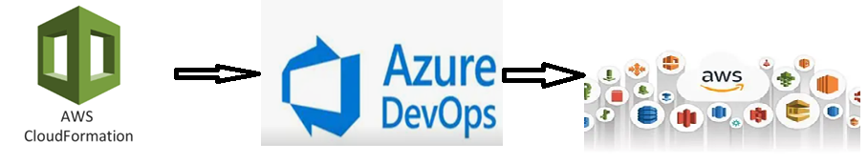
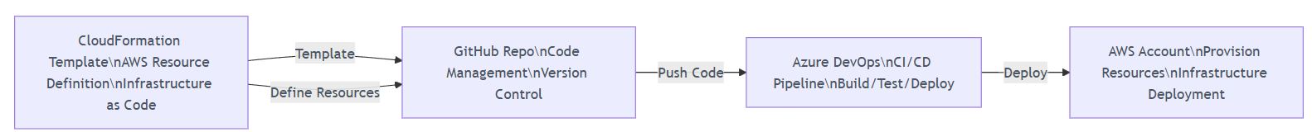
Training Plan: Integrating AWS Basics Resources with Azure DevOps for Infrastructure Deployment
Cloud Infrastructure Deployment Workflow

Slide 2
Training Plan: Integrating AWS Basics resources with Azure DevOps for Infrastructure Deployment
Week | Topic | Content
Week 1.1 | Setting the Stage - Understanding the Landscape & Core AWS Services | Introduction to AWS and Azure DevOps: Why integrate them?; Brief overview of core AWS services: Amazon EC2: Virtual servers in the cloud; Amazon S3: Scalable object storage; Amazon VPC: Logically isolated virtual network; Amazon CloudFront: Content Delivery Network (CDN).
Week 1.2 | Authentication & Authorization - The Secure Connection | Securely connecting Azure DevOps to AWS; Understanding AWS IAM roles for cross-service access; Setting up Azure DevOps service connections for AWS.
Week 2.1 | Infrastructure as Code (IaC) - Defining Your AWS Resources (Part 1) | Introduction to IaC concepts and benefits; Overview of AWS CloudFormation for defining infrastructure; Defining an EC2 Instance using a simple CloudFormation snippet (AMI, instance type).
Week 2.2 | Infrastructure as Code (IaC) - Defining Your AWS Resources (Part 2) | Defining a VPC, subnets, and routing tables within a CloudFormation template; Emphasizing network isolation and control; Illustrating how to define a CloudFront distribution, linking it to an S3 bucket or EC2 as an origin.
Week 3.1 | Building Your First Deployment Pipeline - CloudFormation | Hands-on demonstration: Creating an Azure DevOps pipeline; Deploying a simple CloudFormation stack (e.g., EC2 instance or basic VPC setup); Key steps: Source control, build, release definition.
Week 3.2 | Advanced Pipeline Concepts & Best Practices | Enhancing pipelines with variables; Introduction to multi-stage deployments; Implementing approvals and gates for controlled deployments.
Week 4.1 | Real-World Scenarios, Monitoring, and Next Steps (Part 1) | Demonstrating deploying a more elaborate architecture (multiple EC2 instances within a custom VPC, potentially behind a load balancer); Serving content via CloudFront in a more complex setup.
Week 4.2 | Real-World Scenarios, Monitoring, and Next Steps (Part 2) | Troubleshooting common deployment issues (EC2, VPC, CloudFront) via pipelines; Brief overview of monitoring: CloudWatch for EC2 instances, VPC flow logs, CloudFront access logs; Q&A and next steps for continuous learning.

Slide 3
Week 1.1 Setting the Stage - Understanding the Landscape & Core AWS Services
Introduction to AWS/Cloud and Azure DevOps
Why we integrate AWS and Azure DevOps ?
Brief overview of core AWS services(Compute, storage, Networking etc.)
Amazon EC2: Virtual servers in the cloud
Amazon S3: Scalable object storage
Amazon VPC: Logically isolated virtual network
Amazon CloudFront: Content Delivery Network (CDN).
Account setup : AWS and Azure DevOps and Github repo.
Task: create AWS and Azure DevOps and Github repo in your own environment.

Slide 4
Week 1.1 Setting the Stage - Understanding the Landscape & Core AWS Services
Introduction to AWS/Cloud and Azure DevOps :Azure DevOps, developed by Microsoft, is a suite of tools designed to support the software development lifecycle. It includes:
Azure Boards, Azure Repos, Azure Test Plans, Azure Artifacts.
Why we integrate AWS and Azure DevOps : Integrating AWS and Azure DevOps allows organizations to combine AWS’s robust cloud infrastructure with Azure DevOps’ advanced development tools.
Multicloud Strategy, Automation and CI/CD, Migration and Hybrid Environments , Security and Compliance , Flexibility.
Brief overview of core AWS services:
Compute : On-demand, scalable, cost-effective virtual processing power and resources to run applications and workloads .
EC2, Elastic Beanstalk, Lambda etc.
Networking: VPC: building, managing, and securing your virtual network.(VPC)
Storage : Block storage, File storage, Object storage. (S3).

Slide 5
Week 1.1 Setting the Stage - Understanding the Landscape & Core AWS Services
Amazon EC2: Virtual servers in the cloud:
EC2 provides resizable compute capacity in the cloud, allowing users to launch virtual servers, known as instances, as needed.
Type:
Based and purchasing option
On-demand, reserved, scheduled, spot etc.
Based on workloads:
Compute optimized, memory optimized, accelerated optimized, storage optimized etc.

Slide 6
Week 1.1 Setting the Stage - Understanding the Landscape & Core AWS Services
Amazon S3: Scalable object storage: (Simple Storage Service) is an object storage service offered by AWS. It's designed to provide highly scalable, durable, and available storage for a wide variety of data types, ranging from backups and archives to static website content, data for big data analytics, and more.
S3 Standard
S3 Standard-Infrequent Access
S3 One Zone-Infrequent Access
Amazon S3 Glacier
Amazon S3 Glacier Deep Archive
S3 Intelligent-Tiering
Amazon VPC: Logically isolated virtual network :Amazon VPC allows users to create a logically isolated virtual network in the AWS Cloud, providing control over networking configurations. (subnet, internet gatway, route table etc.)

Slide 7
Week 1.1 Setting the Stage - Understanding the Landscape & Core AWS Services
Amazon CloudFront: Content Delivery Network (CDN):
Amazon CloudFront is a content delivery network (CDN) that delivers static and dynamic content globally with low latency and high transfer speeds. (Region)
Key Features:
Global Reach: Operates over 600 Points of Presence (PoPs) worldwide for fast content delivery.
Caching: Caches content at edge locations to reduce latency for repeated requests.
Security: Supports HTTPS, AWS WAF, and AWS Shield Standard for DDoS protection.
Dynamic Content: Can deliver both static (e.g., images) and dynamic (e.g., APIs) content.
Use Cases: Accelerating website performance, streaming , media, and serving APIs

Slide 8
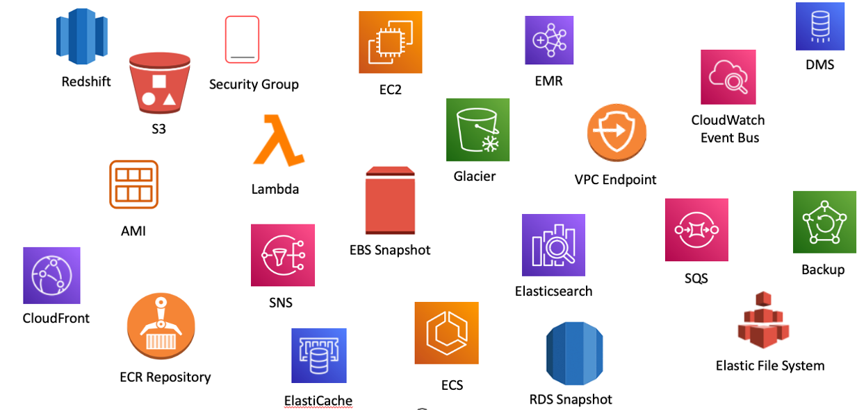
Week 1.1 Setting the Stage - Understanding the Landscape & Core AWS Services AWS Resources

Slide 9
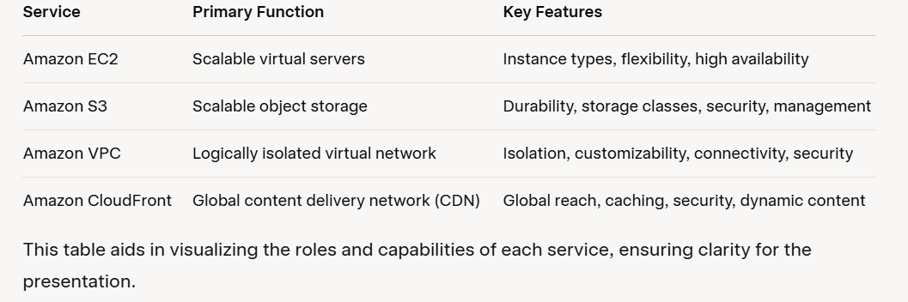
Week 1.1 Setting the Stage - Understanding the Landscape & Core AWS Services Brief overview of core AWS services

Slide 10
Week 1.2 Authentication & Authorization - The Secure Connection
Account setup : AWS and Azure DevOps and Github repo.
Task: create AWS and Azure DevOps and Github repo in your own environment.
Securely connecting Azure DevOps to AWS; Understanding AWS IAM roles for cross-service access; Setting up Azure DevOps service connections for AWS.
Why Connect Azure DevOps to AWS?
The Core Challenge: Cross-Cloud Security
Understanding AWS IAM Roles for Cross-Service Access
Setting up AWS OIDC Provider (OpenID Connect)
Configuring the AWS Service Connection in Azure DevOps
How it Works End-to-End
Best Practices

Slide 11
Week 1.2 Authentication & Authorization - The Secure Connection
Introduction to AWS IAM (Identity and Access Management)
IAM: AWS service for managing access to resources.
Purpose: Controls who (users, roles) can do what (actions) on which resources.
Core Components: Users, Groups, Roles, Policies, Permissions.
Importance: Enhances security and compliance in AWS environments.
IAM Identities and Their Roles
IAM Users: Represent individuals
IAM Groups: Collections of users with shared permissions.
IAM Roles: Temporary credentials for AWS services or external entities.

Slide 12
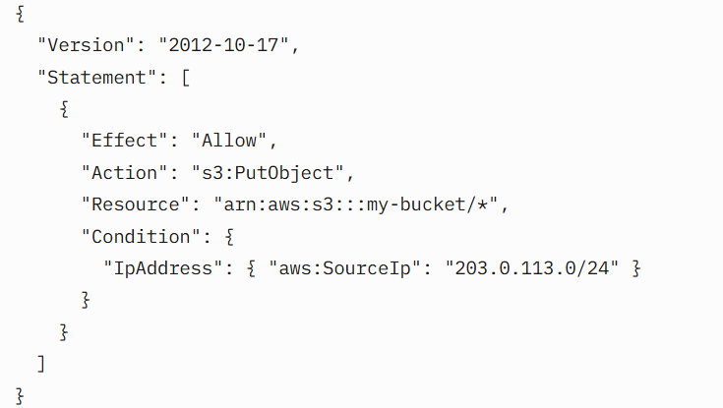
Week 1.2 Authentication & Authorization - The Secure Connection
IAM Policies and Permissions
Policies: JSON documents defining permissions.
Types: Managed (AWS or Customer), Inline.
Structure: Effect (Allow/Deny), Action, Resource, Condition.
Example: Allow s3:PutObject on specific bucket.

Slide 13
Week 1.2 Authentication & Authorization - The Secure Connection
Why Connect Azure DevOps to AWS?
Continuous Integration/Continuous Delivery (CI/CD)
Infrastructure as Code (IaC)
Centralized Orchestration
Hybrid Cloud Strategy
The Core Challenge: Cross-Cloud Security
Authentication & Authorization
Least Privilege Principle
No Hardcoding Credentials

Slide 14
Week 1.2 Authentication & Authorization - The Secure Connection
Understanding AWS IAM Roles for Cross-Service Access
IAM Role : Set of Permissions (Service-to-service access, cross-account access, external integration.)
Trust Policy : OIDC provider.(Define who can assume the role (e.g., EC2, Azure DevOps))
Permissions Policy: s3:PutObject , arn:aws:s3:::my-bucket/*
Temporary Credentials : a role provides short-lived access keys.

Slide 15
Week 1.2 Authentication & Authorization - The Secure Connection
Setting up AWS OIDC Provider (OpenID Connect)
Secure Federation: OIDC allows Azure DevOps to securely authenticate with AWS using a standard protocol.
Azure DevOps as Identity Provider: Azure DevOps acts as the Identity Provider (IdP), and AWS acts as the Relying Party.
URL and Thumbprint: Required details from Azure DevOps (organization URL , unique thumbprint) to configure the OIDC provider in AWS IAM.
Trust Policy Condition: This contains conditions to ensure only your specific Azure DevOps organization can assume the role.

Slide 16
Week 1.2 Authentication & Authorization - The Secure Connection
Configuring the AWS Service Connection in Azure DevOps
Service Connection Type: Choose 'AWS' as the service connection type.
Authentication Method: Role-based: Select 'Role-based authentication' (this is where OIDC comes in).
AWS Account ID: Provide the target AWS account ID.
IAM Role ARN: Specify the Amazon Resource Name (ARN) of the IAM role you created for Azure DevOps.
IAM Role ARN: Specify the Amazon Resource Name (ARN) of the IAM role you created for Azure DevOps.
External ID (Optional but Recommended): A unique string to prevent confused deputy problem.

Slide 17
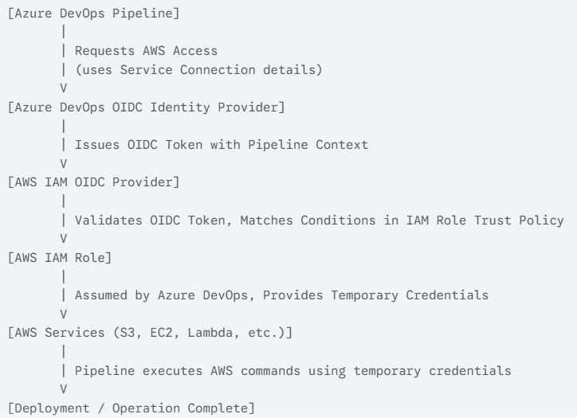
Week 1.2 Authentication & Authorization - The Secure Connection
How it Works End-to-End

Slide 18
Week 1.2 Authentication & Authorization - The Secure Connection
Best Practices:
Least Privilege: Always grant only the minimum necessary permissions to the IAM role.
Separate Roles per Project/Environment: Create distinct IAM roles and service connections for different projects or environments (Dev, Test, Prod) to isolate permissions.
Regular Auditing: Monitor IAM role activity using AWS CloudTrail to track who assumed roles and what actions were performed
Use External ID: Always leverage the External ID feature for OIDC-based role assumption
Automate Setup: Use IaC tools (e.g., CloudFormation, Terraform) to define your IAM roles and OIDC providers for consistency and repeatability.

Slide 19
Week 2.1 Infrastructure as Code (IaC) - Defining Your AWS Resources (Part 1)
Introduction to IaC concepts and benefits;
Overview of AWS CloudFormation for defining infrastructure;
Defining an EC2 Instance using a simple CloudFormation snippet (AMI, instance type, key-pair, Security Group).

Slide 20
Week 2.1 Infrastructure as Code (IaC) - Defining Your AWS Resources (Part 1)
Introduction to IaC Concepts and Benefits
What is Infrastructure as Code (IaC)?
Managing and provisioning infrastructure through code instead of manual processes.
Treating infrastructure configuration like application code (version control, testing, automation).
Examples: Servers, databases, networks, load balancers, etc.
Key IaC Concepts:
Declarative vs. Imperative:
Declarative: Describe the desired state
Imperative: Specify the steps to achieve the
Idempotency: Applying the same IaC code multiple times yields the same result without unintended side effects.
Version Control: Storing infrastructure definitions in systems like Git for tracking changes, collaboration, and rollback.

Slide 21
Week 2.1 Infrastructure as Code (IaC) - Defining Your AWS Resources (Part 1)
Overview of AWS CloudFormation for Defining Infrastructure
What is AWS CloudFormation?
An Amazon Web Services (AWS) service for defining and provisioning AWS infrastructure resources using a simple text file.
It's a declarative service – you describe what you want, and CloudFormation handles the creation, update, and deletion.
Supports YAML and JSON formats for template definitions.
Core Concepts:
Templates
Stacks
Change Sets
Nested Stacks

Slide 22
Week 2.1 Infrastructure as Code (IaC) - Defining Your AWS Resources (Part 1)
How CloudFormation Works
Author Template: Write your infrastructure definition in a YAML or JSON template.
Upload Template: Upload the template to CloudFormation.
Create Stack: CloudFormation reads the template, makes API calls to AWS services to provision resources, and tracks their state.
Manage: Update or delete stacks as needed.
Advantages of CloudFormation
Native AWS integration.
Manages resource dependencies automatically.
Built-in rollback capabilities on failure.
No cost for the CloudFormation service itself (you pay for the underlying AWS resources).

Slide 23
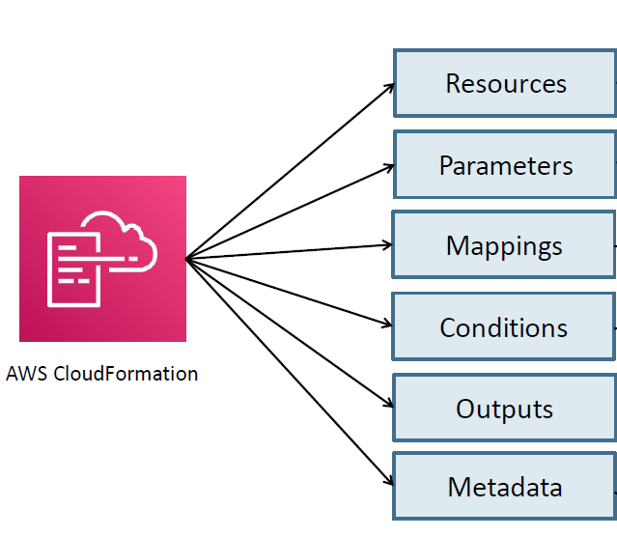
Week 2.1 Infrastructure as Code (IaC) - Defining Your AWS Resources (Part 1)
Template Anatomy

Slide 24
Week 2.1 Infrastructure as Code (IaC) - Defining Your AWS Resources (Part 1)
Resources
Resources are key components of a stack.
Resources section is a required section that need to be defined in cloud formation template.
Ressources Documentation:
https://docs.aws.amazon.com/AWSCloudFormation/latest/TemplateReference/aws-template-resource-type-ref.html

Slide 25
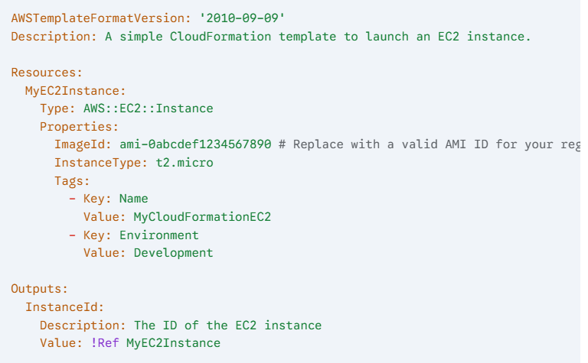
Week 2.1 Infrastructure as Code (IaC) - Defining Your AWS Resources (Part 1)
Defining an EC2 Instance using a Simple CloudFormation Snippet:

Slide 26
Week 2.1 Infrastructure as Code (IaC) - Defining Your AWS Resources (Part 1)
1. Manually Create and ec2 and have an overview on resources.
Instance Id
Instance Type
Keypair, Security Group
Pre-requisites:
Create default VPC
create two key pairs (cfn-keypair-1, cfn-keypair2)
select ami
2. Begin With AWS CloudFormation templating:
Clone GitHub Repo to Visual Studio Code.
Start templating.
Basic/Mandatory Key to Define in Template:
AWSTemplateFormatVersion: 2010-09-09
Description: Provides a human-readable description of the template
Resources: The core section where you define your AWS resources.

Slide 27
Week 2.1 Infrastructure as Code (IaC) - Defining Your AWS Resources (Part 1)
1. Upload CFT Template to AWS console and create the EC2 and validate Instance type, Ami id, Security Group, key pair.
2. Add new Resource security group and re-run the CFT template and validate post creation and working of the security group.
3.Define parameters for keypairs, instance type , and image id.

Slide 28
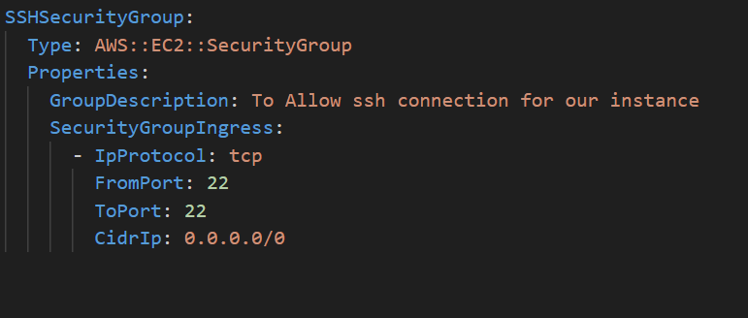
Week 2.1 Infrastructure as Code (IaC) - Defining Your AWS Resources (Part 1)
2. Add new Resource security group and re-run the CFT template and validate post creation and working of the security group.

Slide 29
Week 2.1 Infrastructure as Code (IaC) - Defining Your AWS Resources (Part 1)
Intrinsic Function: Ref
The intrinsic function Ref returns the value of the specified parameter or resource.
•Resource Case: When we specify a resource logical name, it returns a value that we can typically use to refer to that resource.
•Parameter Case: When we specify a parameter logical name, it returns the value of that parameter.
•Syntax:
•Long Form
Ref: logicalName
•Short Form
!Ref logicalName

Slide 30
Week 2.1 Infrastructure as Code (IaC) - Defining Your AWS Resources (Part 1)
Parameters
•Parameters: Parameters enable us to input custom values to our template each time when we create or update stack.
•We can have maximum of 60 parameters in a cfn template.
•Each parameter must be given a logical name (logical id) which must be alphanumeric and unique among all logical names within the template.
•Each parameter must be assigned a value at runtime for AWS CloudFormation to successfully provision the stack. We can optionally specify a default value for AWS CloudFormation to use unless another value is provided.
Parameters must be declared and referenced within the same template.
We can reference parameters from the Resources and Outputs sections of the template.
Syntax

Slide 31
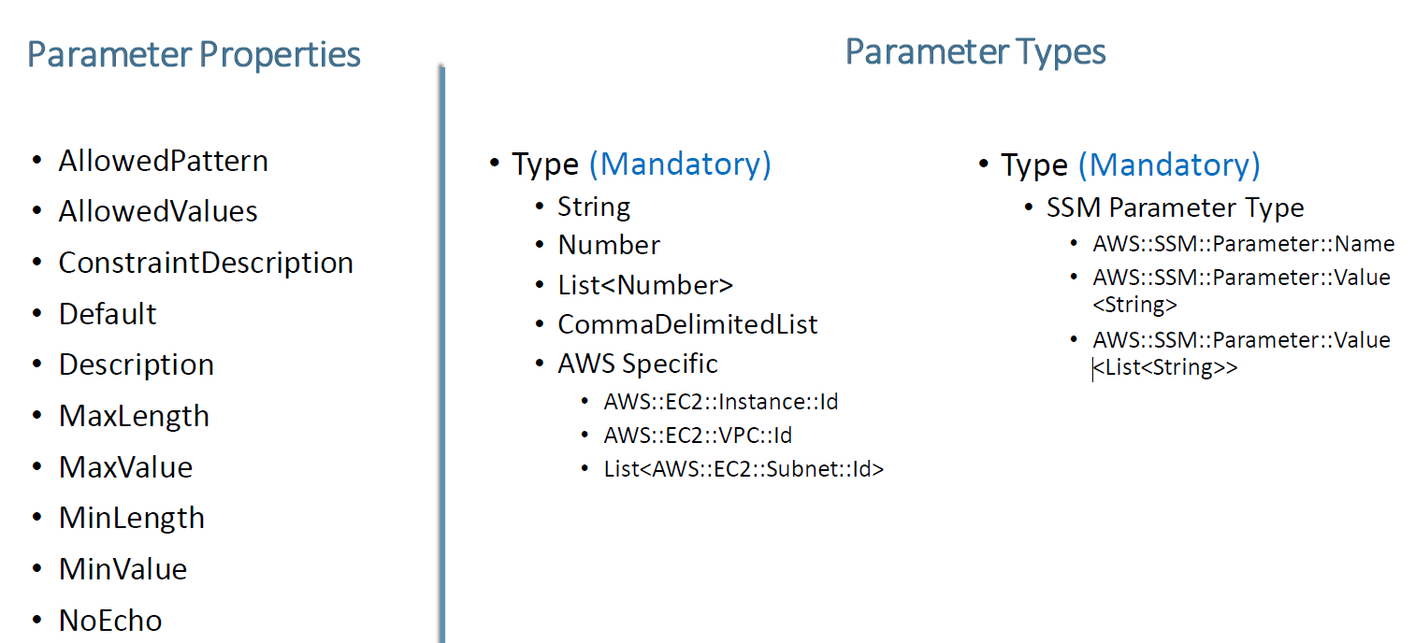
Week 2.1 Infrastructure as Code (IaC) - Defining Your AWS Resources (Part 1)

Slide 32
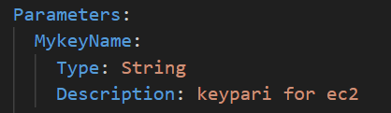
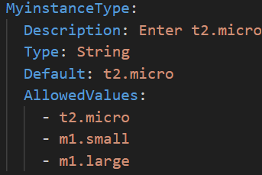

Week 2.1 Infrastructure as Code (IaC) - Defining Your AWS Resources (Part 1)
3.Define parameters for keypairs, instance type , and image id.

Slide 33
Week 2.2 Infrastructure as Code (IaC) - Defining Your AWS Resources (Part 2)
Defining a VPC, subnets, and routing tables within a CloudFormation template. Emphasizing network isolation and control (VPC, subnets, and routing tables )
Illustrating how to define a CloudFront distribution, linking it to an S3 bucket or EC2 as an origin.

Slide 34
Week 2.2 Infrastructure as Code (IaC) - Defining Your AWS Resources (Part 2)
Defining a VPC, subnets, and routing tables within a CloudFormation template;
VPC
Internet Gateway
Attach internet gateway.
Subnet (public /Private )
Route Table >Route(define path of internet /nat gatway > route association(to route table and subnet)

Slide 35
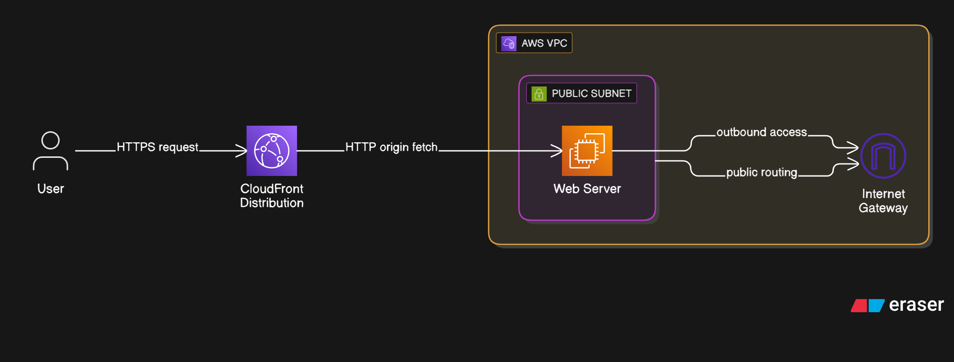
Week 2.2 Infrastructure as Code (IaC) - Defining Your AWS Resources (Part 2)
Illustrating how to define a CloudFront distribution, linking it to an S3 bucket or EC2 as an origin.

Slide 36
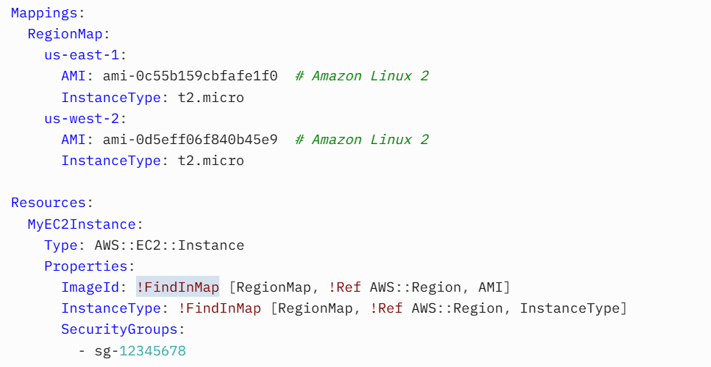
Week 2.1 Infrastructure as Code (IaC) - Defining Your AWS Resources (Part 1)
Mapping: Mappings are a way to define key-value pairs in a CloudFormation template to store static values that can be referenced based on specific conditions, such as AWS regions, environments, or instance types. They are useful for avoiding hardcoded values and making templates more portable.

Slide 37
Week 3.1 Building Your First Deployment Pipeline - CloudFormation
Hands-on demonstration: Creating an Azure DevOps pipeline;
Deploying a simple CloudFormation stack (e.g., EC2 instance or basic VPC setup);
Key steps: Source control, build, release definition.
Articles about DevOps and CI/CD?
What is Continuous Integration?: (automatically building and testing code every time a team member commits code changes to version control)
What is Continuous Delivery?: (automating build, test, configuration, and deployment from a build to a production environment.)
What is DevOps? : (union of people, process, and technology to continually provide value to customers.)

Slide 38
Week 3.1 Building Your First Deployment Pipeline - CloudFormation
Hands-on demonstration: Creating an Azure DevOps pipeline
Install AWS toolkit on azured DevOps organization.
>>>(AZURE ORGANIZATION>MARKETPLACE>AWS TOOLKIT)
Creation of OpenID Connect (OIDC)(by creating the IAM role) to utilized in service connection.
(follow the below documentation to federate into AWS from Azure DevOps using OpenID Connect . How to federate into AWS from Azure DevOps using OpenID Connect | Microsoft Workloads on AWS
AWS Service Connection in Azure DevOps:
1.Go to Project Settings > Service Connections > New service connection.
2.Select AWS and choose OpenID Connect (OIDC).

Slide 39
Week 3.1 Building Your First Deployment Pipeline - CloudFormation
Deploying a simple CloudFormation stack (e.g., EC2 instance or basic VPC setup)
Creation of YAML CI / CD Azure Pipeline :
Choose repository.
Select project under repository.
Select type of pipeline (with existing or new file )and configure the task under pipeline.
Key Components:
Triggers: Run the pipeline on code pushes or pull requests.
Set the pull request.
Variables: Store configuration details (e.g., AWS region, stack name).
Jobs:
CI Job: Validates the template using AWS CLI.
CD Job: Deploys the stack using AWS CLI, with an approval gate.
https://learn.microsoft.com/en-us/azure/devops/pipelines/yaml-schema?view=azure-devops

Slide 40
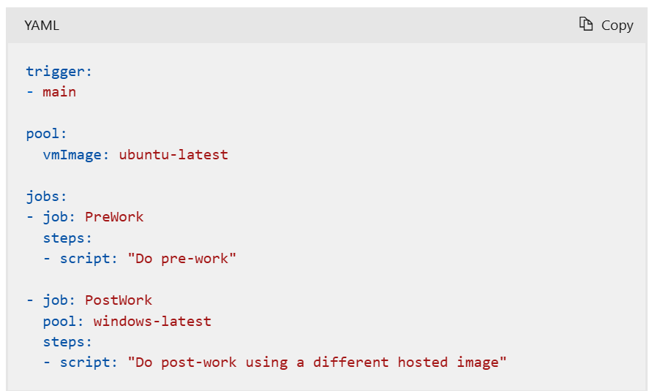
Week 3.1 Building Your First Deployment Pipeline - CloudFormation
Examples

Slide 41
Week 3.1 Building Your First Deployment Pipeline - CloudFormation
Steps To write the Basic yaml pipeline for CI/CD CloudFormation execution.
To set the trigger on branch as per your requirement.
Set the pr.
Set the pool as per our requirement .
Define the variables for CFT.
Define the jobs:
For CI
Define CI as jobs with labels(display name)
Steps required for self checkout of codes and task for AWSshellscript to validate CloudFormation Template.
Define the input and shell script command for AWSshellcript to validate the CFT.
https://docs.aws.amazon.com/cli/latest/reference/cloudformation/validate-template.html - aws shell script to validate the cloudformation validate-template command
For CD
Define deployment type with labels.
Steps required for self checkout of codes and task for AWSshellscript to Deploy CloudFormation Stack.
Define the input and shell script command for AWSshellcript to validate the CFT.
Dependencies.
Condition

Slide 42
Week 3.1 Building Your First Deployment Pipeline - CloudFormation
Steps To write the Basic yaml pipeline for CI/CD CloudFormation execution.
To set the trigger on branch as per your requirement.
Set the pr.
Set the pool as per our requirement .
Define the variables for CFT.
Define the jobs:
For CI
Define CI as jobs with labels(display name)
Steps with required task (for bringing the code /checkout and for and AWSshellscripti) with proper labels.
Define on what input we need to run the AWSshellcript.
https://docs.aws.amazon.com/cli/latest/reference/cloudformation/validate-template.html - aws shell script to validate the cloudformation validate-template command
For CD
Define CI as jobs with labels(display name)
Dependencies.
Condition
Environment
Strategies type followed by steps.Steps with required task (for checkout and for and shellscripti) with proper labels.

Slide 43
Week 3.2 Advanced Pipeline Concepts & Best Practices
Enhancing pipelines with variables;
Introduction to multi-stage deployments;
Implementing approvals and gates for controlled deployments.

Slide 44
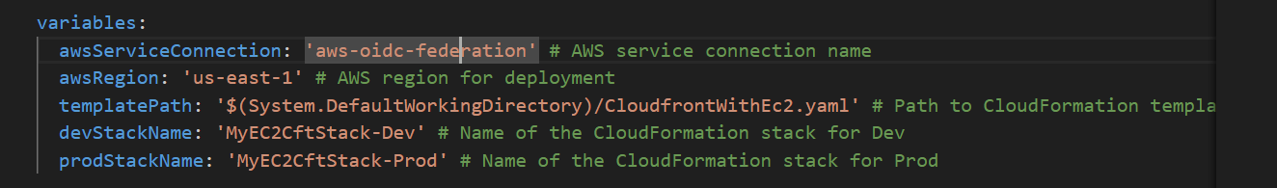
Week 3.2 Advanced Pipeline Concepts & Best Practices
Enhancing pipelines with variables;

Slide 45
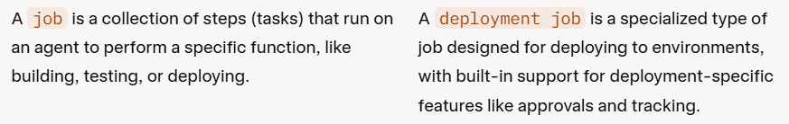
Week 3.2 Advanced Pipeline Concepts & Best Practices
Introduction to multi-stage deployments;
Setting up dev and prod environment by using below strategies.
Define jobs into stages to accomplish the multistage and environment.(stage name with labels.)
Set jobs as deployements
>dev deployements(add stage and deployment strategies)
>prod deployementsadd stage and deployment strategies)
Setup the environment with strategies type.
In environment library setup the approval and checks for prod

Slide 46
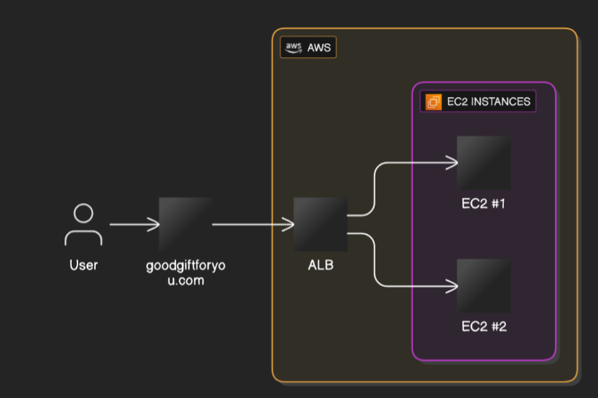
Week 4.1 Real-World Scenarios, Monitoring, and Next Steps (Part 1)
Demonstrating deploying a more elaborate architecture (multiple EC2 instances within a custom VPC, potentially behind a load balancer);
Serving content via CloudFront in a more complex setup.
Goodgift.fashin

Slide 47
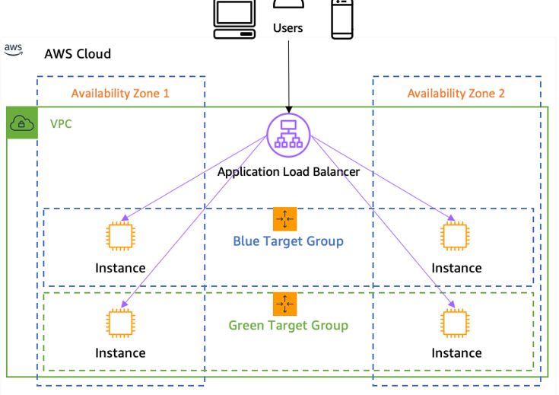
Week 4.1 Real-World Scenarios, Monitoring, and Next Steps (Part 1)
How a load balancer works .:A load balancer distributes incoming network traffic across multiple servers to ensure no single server is overloaded, improving responsiveness and availability.
Target Group.
Listener
Health check

Slide 48
Week 4.1 Real-World Scenarios, Monitoring, and Next Steps (Part 1)
Target Group: A logical grouping of backend servers (or other resources) to which a
load balancer routes traffic.
Listener: A process that checks for connection requests using the protocol and port
that you configure, then forwards requests to one or more target groups based on rules.
Health Check: A periodic test performed by a load balancer to determine if registered
targets are available and ready to receive traffic.
DNS : DNS (Domain Name System) is the internet's "phonebook" that translates human-readable domain names (like https://www.google.com/search?q=google.com) into numerical IP addresses (like 172.217.160.142) that computers use to locate and connect to websites and other internet resources.
SSL/TLS Certificate: (create in AWS ACM): SSL/TLS (Secure Sockets Layer/Transport Layer Security) is a cryptographic protocol that provides secure, encrypted communication between a client (like a web browser) and a server, ensuring data privacy, integrity, and authentication.

Slide 49
Week 4.1 Real-World Scenarios, Monitoring, and Next Steps (Part 1)
Step to configure DNS in AWS:
Purchase DNS from AWS or another DNS provider.
Transfer DNS to Route 53
Update Name Servers in another DNS provider(GoDaddy)
(Optional) Add SSL Validation Record:
If using ACM with DNS validation, Route 53 can automatically add the CNAME record for certificate validation.
Wait for DNS Propagation:
DNS changes (especially name server updates) may take 5 minutes to 48 hours to propagate.

Slide 50
Week 4.2 Real-World Scenarios, Monitoring, and Next Steps (Part 2)
Troubleshooting common deployment issues (EC2, VPC, CloudFront) via pipelines;
Brief overview of monitoring: CloudWatch for EC2 instances, VPC flow logs, CloudFront access logs;
Q&A and next steps for continuous learning.

Slide 51
Week 4.2 Real-World Scenarios, Monitoring, and Next Steps (Part 2)
Troubleshooting Guide Link: https://learn.microsoft.com/en-us/azure/devops/pipelines/troubleshooting/troubleshoot-triggers?view=azure-devops
Brief overview of monitoring:
CloudWatch for EC2 instances
sudo apt-get update (yam update –y)
sudo apt-get install -y stress (yum install stress –y) stress --cpu 2 --timeout 600
VPC flow logs
CloudFront access logs

Slide 52
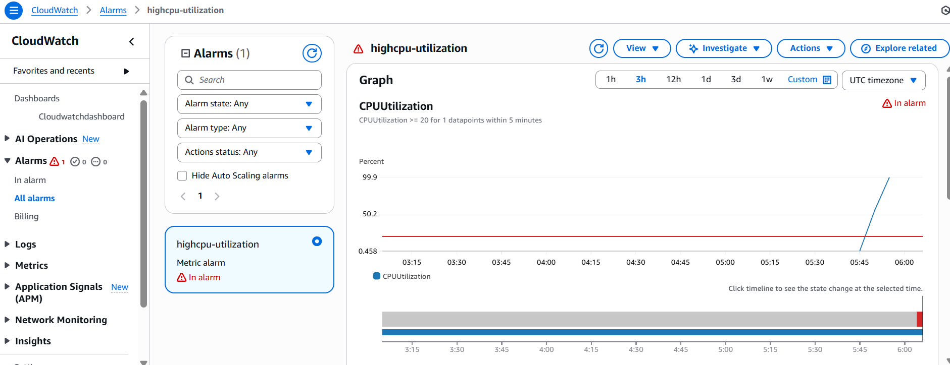
Week 4.2 Real-World Scenarios, Monitoring, and Next Steps (Part 2) CloudWatch for EC2 instances,

Slide 53
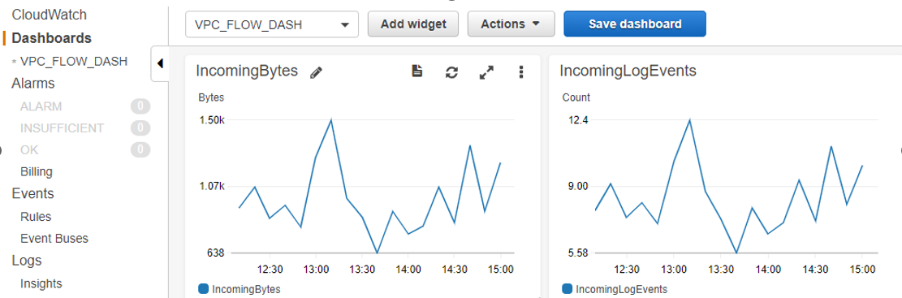
Week 4.2 Real-World Scenarios, Monitoring, and Next Steps (Part 2)
VPC flow logs captures metadata about IP traffic going to and from network interfaces in your Amazon Virtual Private Cloud (VPC).

Slide 54
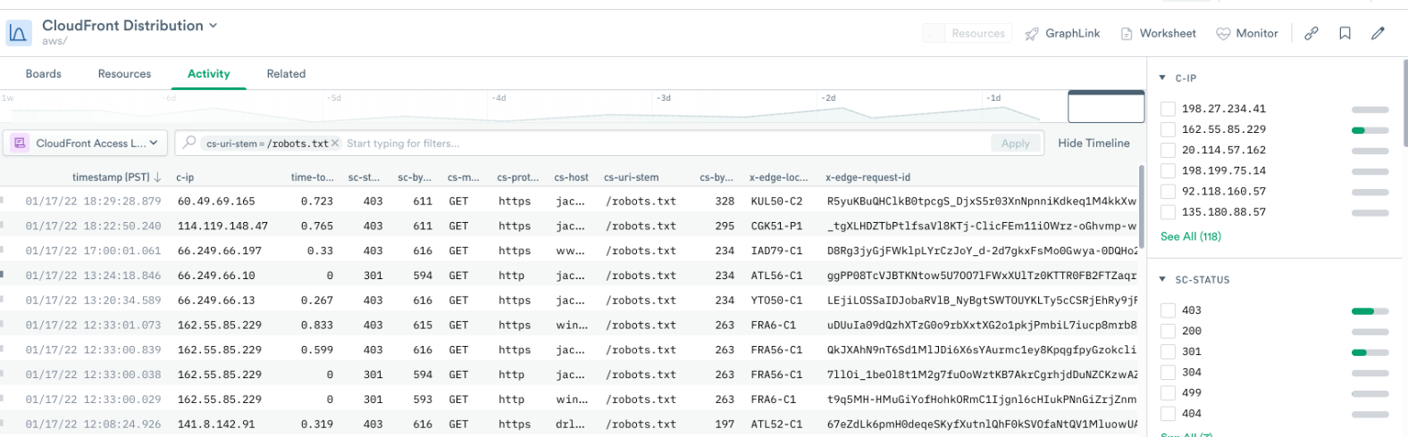
Week 4.2 Real-World Scenarios, Monitoring, and Next Steps (Part 2)
CloudFront access logs
CloudFront Access Logs are detailed records of requests made to an Amazon CloudFront distribution, capturing metadata about HTTP/HTTPS requests, such as the client’s IP address, requested object, response status, bytes transferred, and more

Slide 55
Week 4.2 Real-World Scenarios, Monitoring, and Next Steps (Part 2)
Q&A and next steps for continuous learning.
Important Link:
Github :https://github.com/mintuminuteonline/AzureCloudformationProject
AWS Ressources Documentation (CloudFormation)
https://docs.aws.amazon.com/AWSCloudFormation/latest/TemplateReference/aws-template-resource-type-ref.html
To federate into AWS from Azure DevOps using OpenID Connect . How to federate into AWS from Azure DevOps using OpenID Connect | Microsoft Workloads on AWS
CD Job: Deploys the stack using AWS CLI, with an approval gate.
https://learn.microsoft.com/en-us/azure/devops/pipelines/yaml-schema?view=azure-devops
AWS shell script: https://docs.aws.amazon.com/cli/latest/reference/cloudformation/validate-template.html
Thank You!!!!!!

Slide 56
Pre-Assessment Session task
Task to attendee
Please go through entire course(PPT, GitHub repo , provided documents etc.) , create account ,
CloudFormation template
pipeline and run to create infra.

Slide 57

Assessment
You may get task to create AWS resources (VPC, subnet, EC2, etc.) using a CloudFormation stack, either directly in the AWS Console or through an Azure DevOps pipeline

Slide 58

Thank You!!!!!

